Slide 1
Data294P Executive Level Presentation
AN DL Approach On PEAK Recognition in DNA Sequence
Xiaofei Teng

Slide 2
Background Introduction
This project aims to identify peaks (high accessibility fragments on a DNA sequence), which are associated with condensate formation within Liquid-Liquid Phase Separation (LLPS), through a direct deep learning approach to learn the pattern of the original DNA sequence (the ATCGs).
The overall idea is to do a two-step approach:
Step 1: generate a label for each peak as yes/no to being a target peak
Step 2: feed the DNA sequences of the peaks together with the labels generated in step 1 to a deep neural network and train a model
By successfully building this model, we would have much greater efficiency in identifying these peaks with biological significance. It would save us time, as well as cut short the expense conducting formal experiments.

Slide 3
Background Introduction
One important feature of the peaks we are looking for is that their responses under a specific set of experimental conditions show a certain pattern.
For the three experimental conditions, namely native condition (the control group), chemical fixation (Fix group), and chemical fixation with 1,6-hexanediol (HexFix group), the relative accessibility (which comes in a positive real number) is significantly lower for the Fix group comparing to the other two groups, between which no significant difference is observed.
This is because under chemical fixation, the transcriptional components form multivalent, dynamic, intermolecular inter actions that are sensitive to disruption by 1,6-hexanediol⁽¹⁾.
In conclusion, we are looking for a V-shape pattern across the 3 experimental conditions.

Slide 4
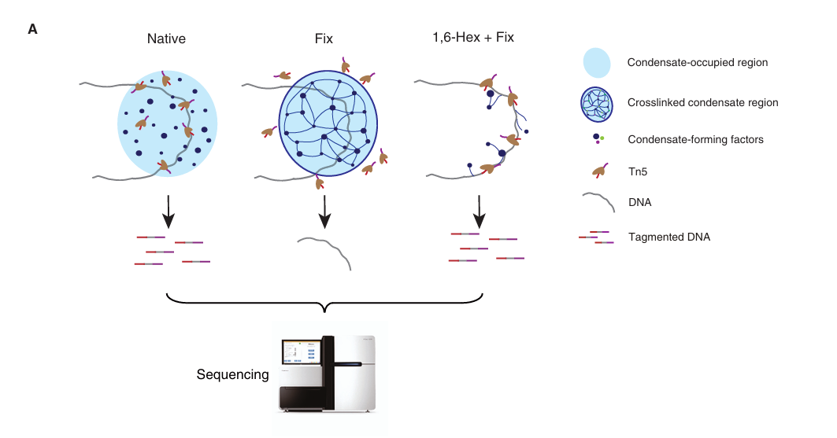
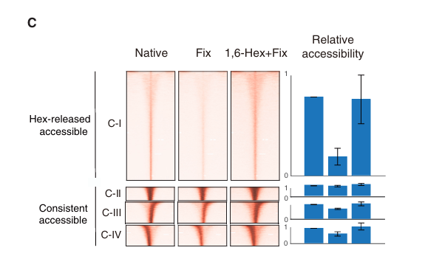

Slide 5
ATAC-seq Technique
The ATAC-seq technique enables the genome-wide detection of chromatin accessibility and plays a crucial role in various fields such as gene regulation and disease mechanisms.
For an individual experimental treatment, raw data produced by ATAC-seq can be converted into a vector using some bioinformatics software. The dimension of the vector is the number of open regions or peaks, with each component representing a peak and its value indicating the relative quantification of accessibility of that peak.

Slide 6
Proper Normalization
By relative quantification, it means that the accessibility values being recorded are relative to other values within the same treatment group. For example, in a certain experimental group, peak A and peak B having accessibilities of 1 and 2 is no different from them having accessibilities of 100 and 200.
If peak A has accessibility 1, 10, and 100 across the Fresh, Fix, and HexFix groups, we cannot directly compare these three numbers, for they are all “relative” to other accessibility values in their specific group. For example, 1 could be the maximum value in Fresh group, while 100 could be the minimum value in HexFix group, then it will be wrong to conclude that 100 is “larger” than 1.
To determine the “pattern” of a peak is to compare the accessibilities across different experimental groups, thus a normalization between groups is necessary before the comparison.

Slide 7
Data Summary
The dataset is consist of 2 subsets, one of which will be used to make labels, the other to train the model.
The first subset only has 1 table, which has 68809 rows, each row represents a peak of length 400 and has 6 columns:
chrom: the name of the chrome the peak is on
start: the start point of the peak
end: the end point of the peak
Fresh: the accessibility read for the control group
Fix: the accessibility read under chemical fixation
HexFix: the accessibility read under chemical fixation with 1,6-hexanediol

Slide 8
The second subset has 2 tables, each has 137923 rows; each row represents a peak of length 600. The first table in this subset has the following columns:
chrom: the name of the chrome the peak is on
start: the start point of the peak
end: the end point of the peak
id: the name of peak
signal: a signal strength calculated by a bio-info specific software when generating the sequence
label: labels generated from the first step
intensity: the average intensity for the sequence (the true intensity of a sequence should be a distribution with one read for each nucleotide, but here I just get the average over the distribution)

Slide 9
The second table has the following columns:
id: the name of the peak
sequence: the actual sequence (consist of A, T, C, G, and N) of the peak, length is 600
Note that the peaks of the two subsets are not of a 1-to-1 relationship. The peaks in subset 1 underwent a special treatment called overlapping (which is not done by me), and as a result, peaks in subset 1 could correspond to one or several peaks in subset 2, while some peaks in subset 2 are not included in subset 1 at all.

Slide 10
Project Outline
Data normalization
Data transformation
Clustering algorithm (Kmeans) to generate label
Data cleaning
One-hot encoding DNA sequence
Train a CNN model using the one-hot encoded sequence and generated label
Discussion

Slide 11
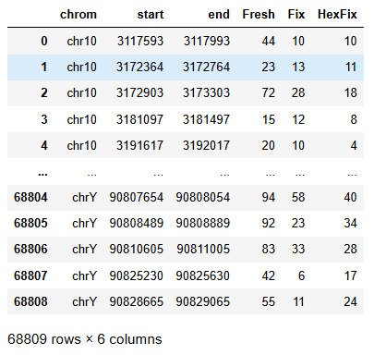
Data Normalization
As mentioned before, proper normalization is necessary before comparison between groups. But even before that, let us take a closer look at our data:

Slide 12
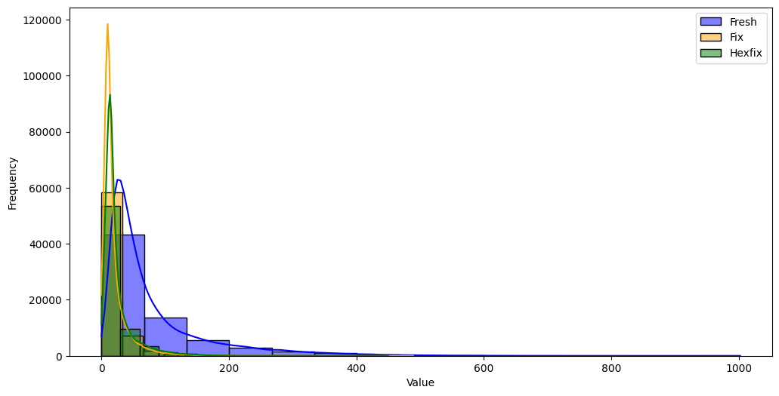
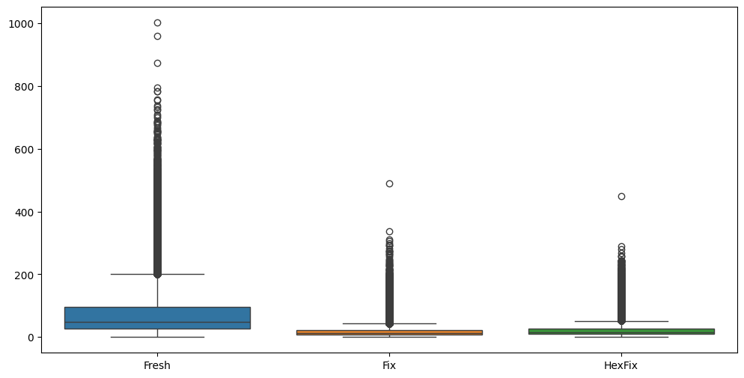
From both the histogram and the box plot we can see that the data is very skewed to the right, and also the three columns are of different “scale”.

Slide 13
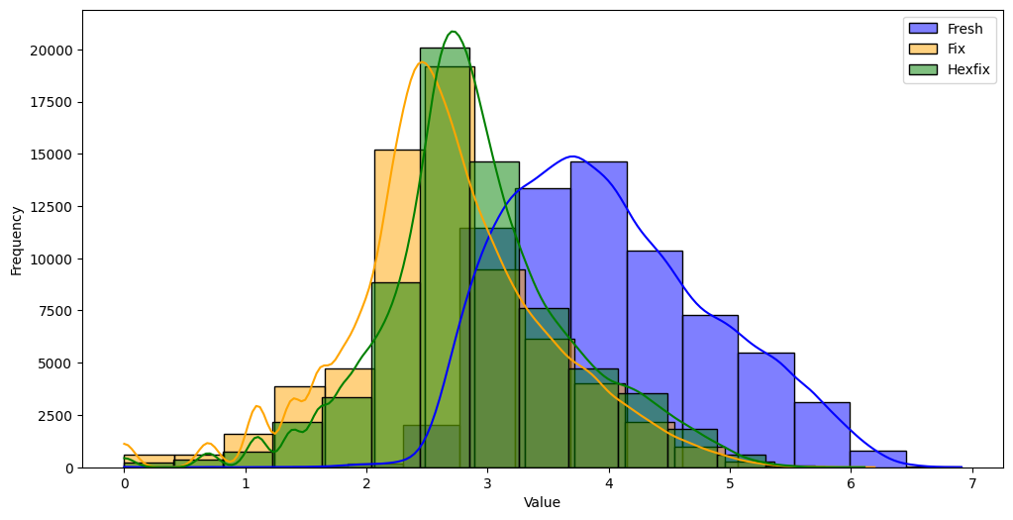
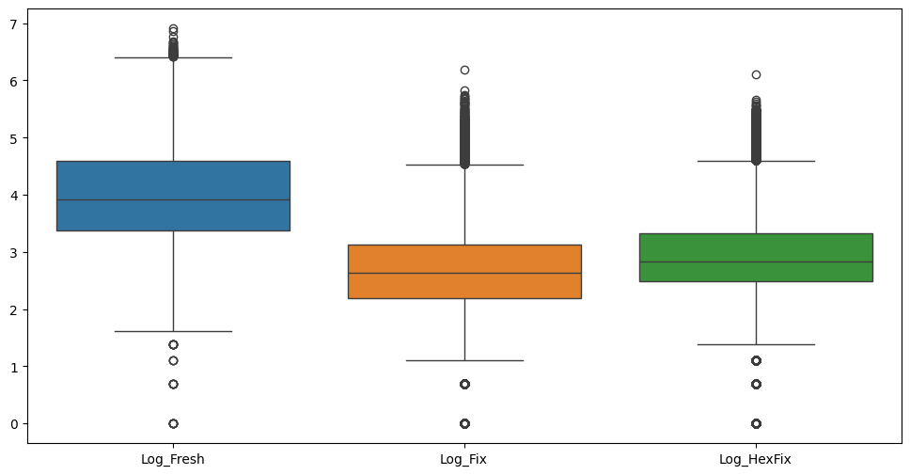
One common approach to deal with data with a long tail is to apply a log transformation. Here, a log2 transformation is used. Can see the data become more “normal” after applying the log transformation.

Slide 14
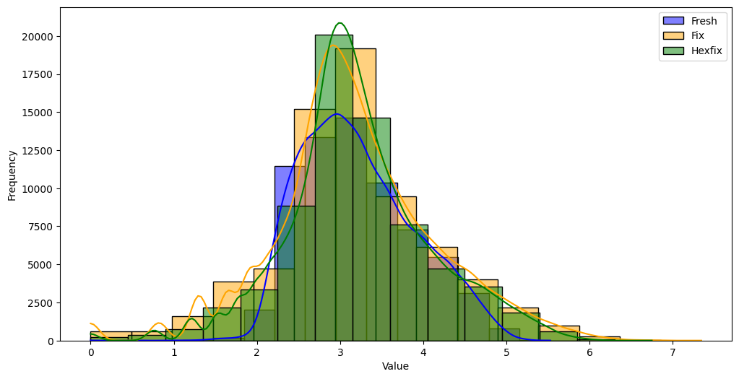
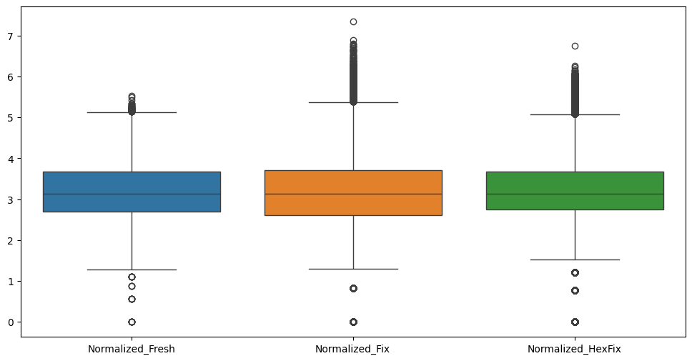
In the field of biological information, quantile normalization is commonly used⁽²⁾. In this project, Median normalization (MED), or the 50-quantile normalization is used. This method lines up the median of each column to make the data be on the same “scale”.

Slide 15
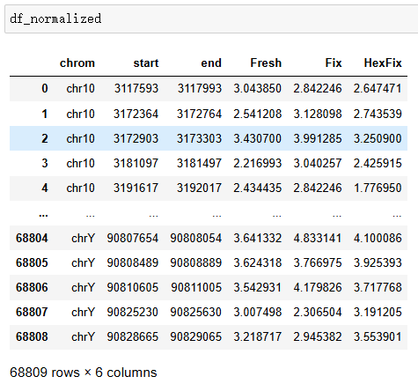
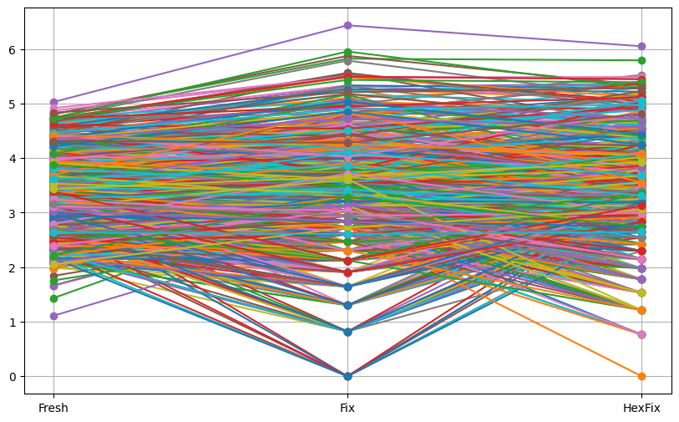
After Normalization
Line plot for the first 1000 rows

Slide 16
Data Transformation
Now we have 3 normalized columns. Before we feed the data to a clustering algorithm to generate the labels, it is better to apply certain transformations that better capture the feature we care about, and hopefully could improve the clustering result.
Some possible transformation methods are:
Z-score transformation (does not do a significantly better job to capture wanted features, and might have problems)
Difference transformation (simple and effective)
HSV transformation (very good at capturing the “shape” pattern and cool)

Slide 17
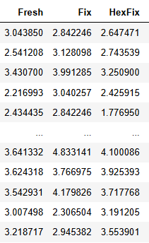
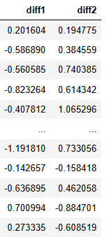
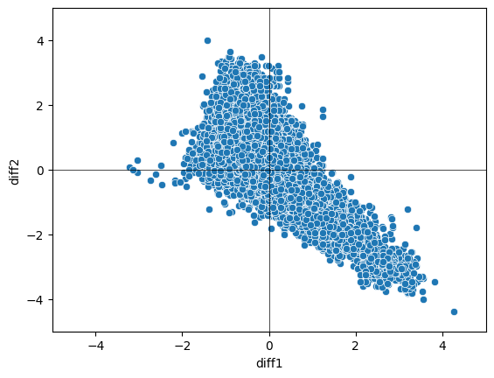
Difference transformation
Transform (Fresh, Fix, HexFix) to (Fresh - Fix, Fix - HexFix)
Advantage: focuses on the difference feature we care about, dimension reduction, visualization possible
Disadvantage: loss of information

Slide 18
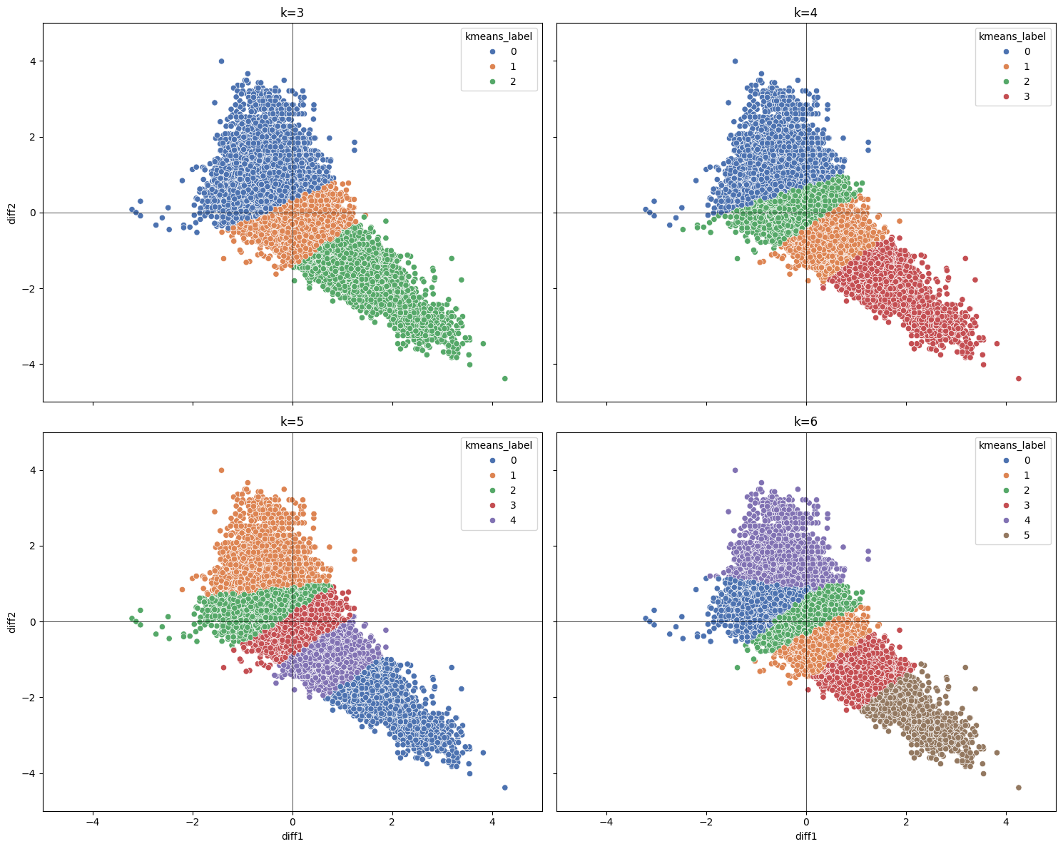
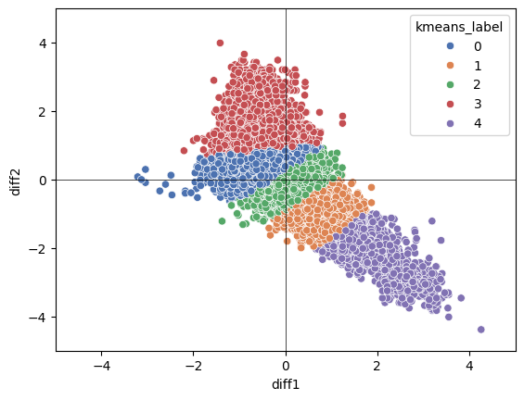
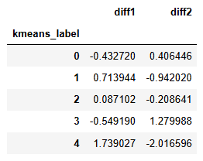

Kmeans
Kmeans result for k=5
Mean of each label

Slide 19
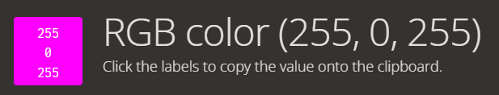
HSV transformation
Say we have a tuple (R, G, B) representing a color. Imagine you have a V-shape pattern for the RGB values (high R and B value, low G value), what color could it possibly look like?
Could it be that the V-shape pattern we are looking for is simply within a specific color range when converted into a RGB color?

Slide 20
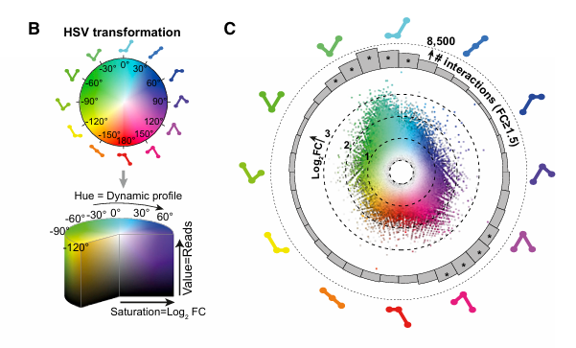
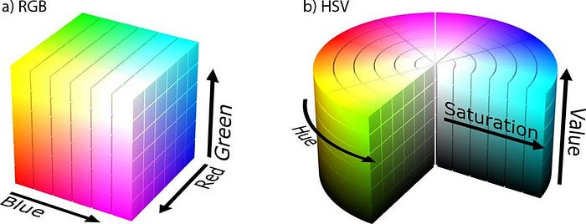
Indeed this is the case! If we treat the (Fresh, Fix, HexFix) tuple as RGB values of a color, all V-shape tuples should represent a color within a certain color range, in other words, a color which hue is in a certain range (when transformed into a HSV color).
Siersbæk et al., 2017. ⁽³⁾

Slide 21
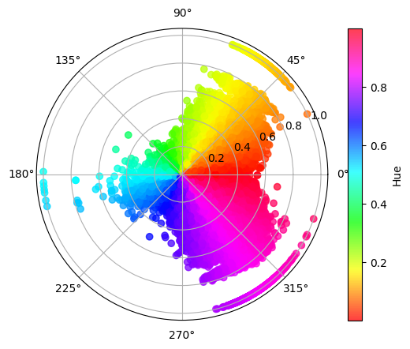
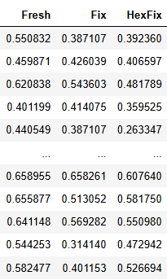
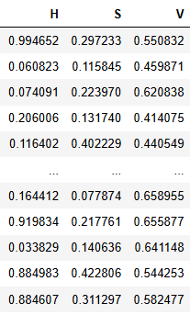
The columns are normalized to be between [0, 1] for convenience of HSV transformation
HSV values are also between [0, 1]

Slide 22
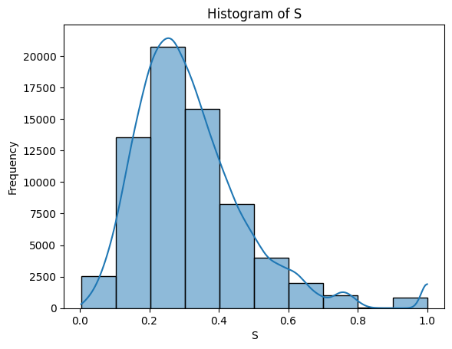
Interpretation of HSV transformation
For a (R, G, B) to (H, S, V) transformation:
H is the “shape” of the R-G-B angle
S is (max – min) / max, where max, min are the maximum, minimum value in (R, G, B)
V is the max value in (R, G, B)
Except for certain H range (the V-shape), we also look for certain S range (how deep the “V” is).

Slide 23
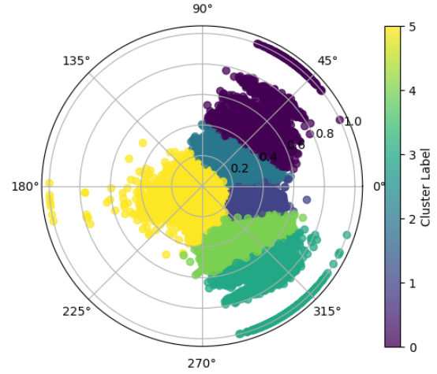
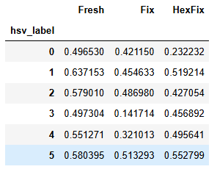

Kmeans
Mean of each label
Count of each label

Slide 24
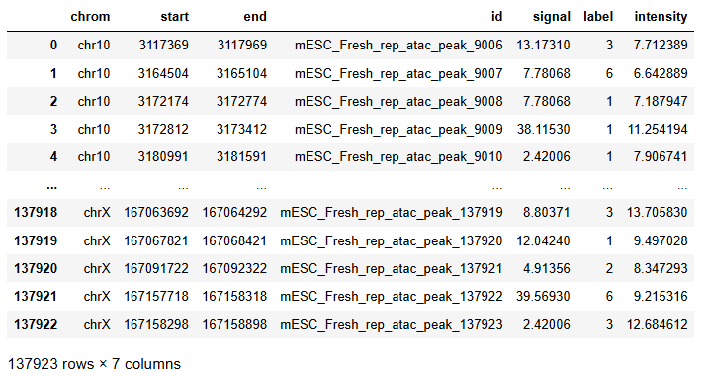
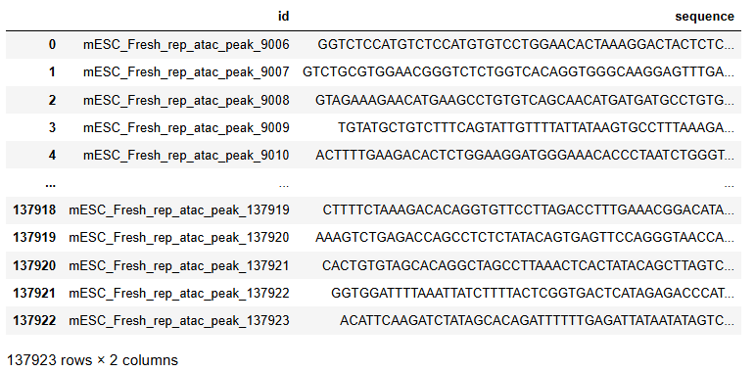
Data cleaning
The second subset comes in a very strange format (at least strange to me): .bed and .fa file.
.bed file can be read by pandas using the read_csv function and use ‘\t’ as delimiter.
.fa file is generated by a software called FASTA, which is wildly used in bioinformatics to store nucleotide or protein sequences. In python, it has to be read using special package functions (SeqIO function from Bio package).
This is what the dataset looks like, it is thus easy to see that the two tables can join on a common key, id:

Slide 25
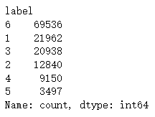
There are some problems to be solved before this data could be used to train a model. First, the labels of the peaks are from 1 to 6, while labels 1 to 5 represent class 0 to 4 in the Kmeans result in former step, while label 6 represents “unlabeled”. Thus, we have to delete all rows with label 6 (this is nearly half of the data), and reduce all label by 1 to get the original label we generated from the clustering algorithm.
I also swap label 0 with label 4, so that label 0 now represents the V-shape we are looking for. This saves time for me to remember which label is the label we target at.

Slide 26
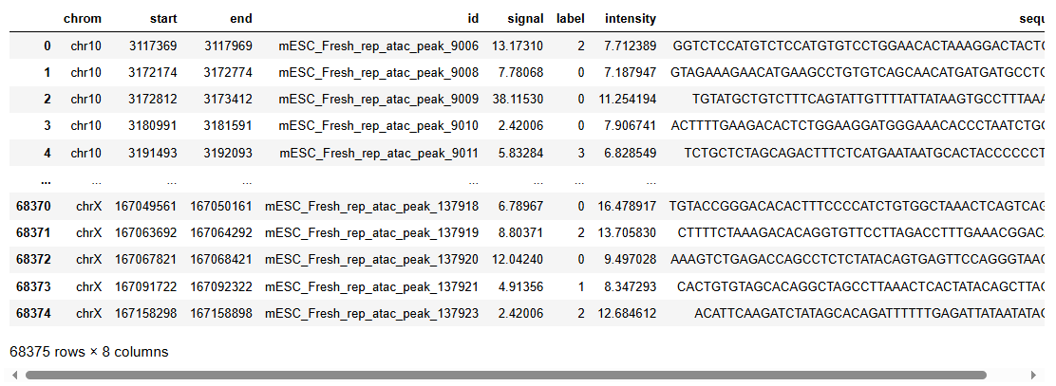
Another problem is that, besides A, T, C, and G, there is also a N nucleotide in the sequence column, which represents “unknown” or “any” nucleotide. We do not want this noise in our model, so I want to delete all rows whose sequence contains the N nucleotide.
This is what the data looks like after data cleaning:
While we got rid of nearly half the data, we still have about the same amount of rows in remain comparing to the first dataset, so it’s not too bad.

Slide 27
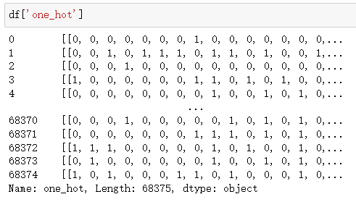
One-hot encoding
A common approach to extract patterns from a sequence in bioinformatics is to one-hot encode the sequence, so that a sequence of length n becomes a matrix of 4*n. This matrix is then fed into a CNN to extract the spatial information for further analysis. The methodology used in this project has referred to a paper by Han Yuan and David R. Kelley (2022)⁽⁴⁾.
This is how the one-hot encoding looks like:

Slide 28
CNN architecture
Because of the property of one-hot encoding, namely that each column can only have one “1” entry, the row-wise (or between-row) relationship is naturally of less significance than column-wise (or within-row) relationship. This property has led to a certain kind of CNN architecture we use in this project.
Instead of the Conv2d layer, which has a 2d kernel and is usually used on spatial data, here we use Conv1d layer, which has a 1d kernel and is usually used on sequential data. In this specific example, we treat each row as a individual sequence and apply Conv1d layer to it to get a new sequence for each channel. This approach has a corresponding bioinformatics significance: for example, the first row could be interpreted as the distribution of ‘A’ nucleotide.

Slide 29
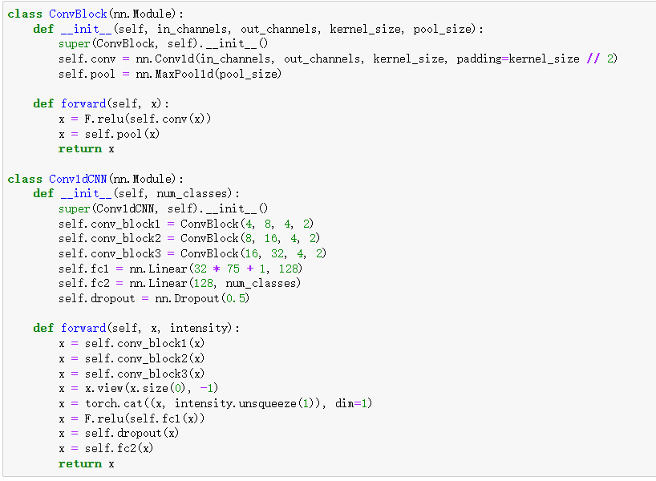
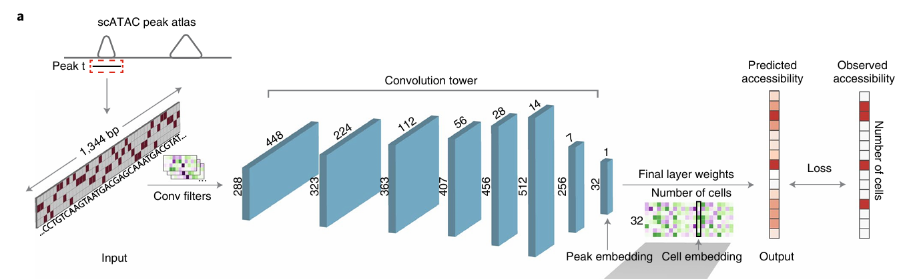
CNN architecture
The CNN architecture design also have referred to the paper by Han Yuan and David R. Kelley (2022)⁽⁴⁾.

Slide 30
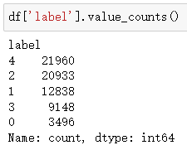
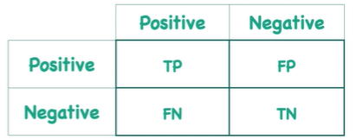
Training and evaluation
Data is randomly sampled from the original dataset with a 80%/20% train/test split ratio
Default sample size 20000 (16000 training data and 4000 validation data)
Use cross entropy loss
Learning rate set to be 0.001, with 1e-4 weight decay
Train 20 epochs, record the training and validation loss for each epoch, plot the loss when finished
Evaluate on both the overall accuracy and the accuracy on our target label (label 0 in this case) to prevent the model from biased of unbalanced label amount

Slide 31
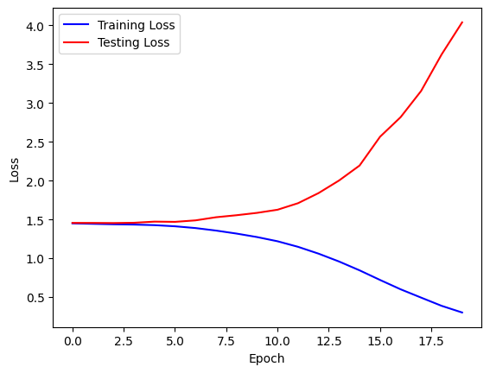
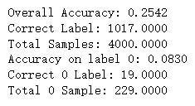
Result
Long story short, the CNN model does not work out well. The validation loss almost always goes up immediately after the training loss starts to go down (as shown below). This is a strong sign of overfitting in ML, where the model simply “remember” the data instead of “learn” the underlying pattern, which makes the model impossible to generalize to unseen data.

Slide 32
Discussion
Several possible reasons might lead to this result:
There’s a problem with the model
The model is too complicated for the data
The model architecture does not fit the data
There’s a problem with the data
The data has too little pattern/too much noise
The labels have poor quality

Slide 33
Tuning model complexity
There is a relative relationship between the amount of training data and the complexity of the model for the model to be able to completely remember the data. To ameliorate the situation, we could work from both sides:
To feed more data
To simplify the model
Reduce the number of parameters in the convolutional layers
Add regularization (already applied in the original model)
Add dropout layer
If the loss curve shows significantly different pattern with more data/simpler architecture, then model complexity could very possibly be the true cause to this overfitting outcome.

Slide 34


Simplifying Convolutional layer
Although the deletion of “self.conv_block3” does not change the number of input parameters to the first fully connected layer (from 32*75+1 to 16*150+1), it directly remove all parameters within this layer ((16*2+1)*32 parameters, more than the first 2 convolutional layers added up). By eliminating more than half the parameters in the convolutional layers, this approach significantly reduce the complexity of the model.

Slide 35
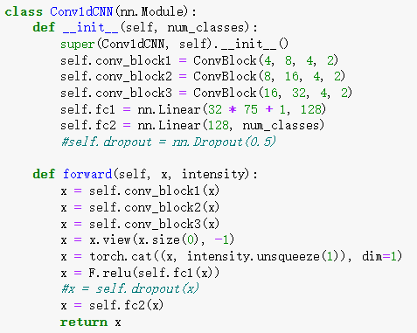
Adding Dropout Layer
The dropout layer is conventionally added in between the two fully connected layers with a certain dropout rate. Here, I’m using a 0.5 dropout rate, which means 50% of the output parameters of “self.fc1” would be randomly set to be 0 during each training cycle. This significantly prevent overfitting.
Usually, in CNN, we use a smaller dropout rate (0.3 for example), because we want to preserve as much information as possible from the convolutional blocks.

Slide 36
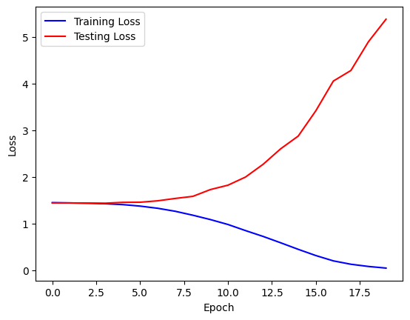
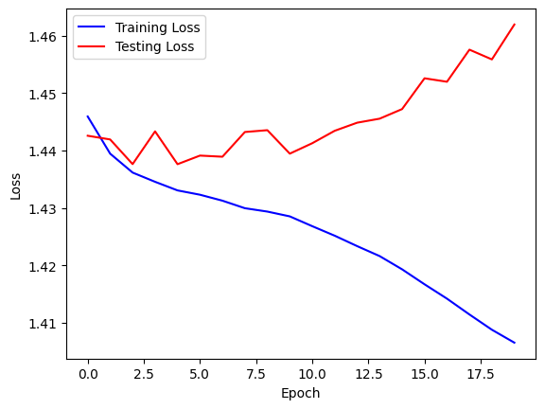
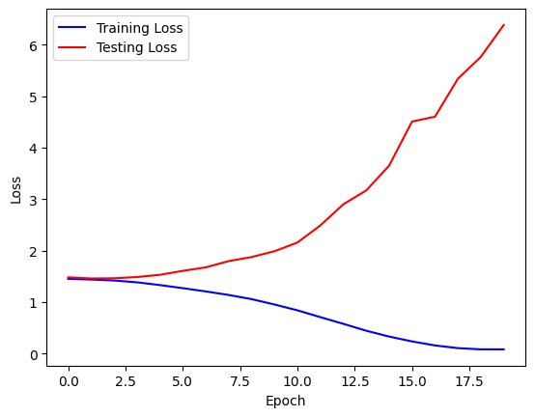
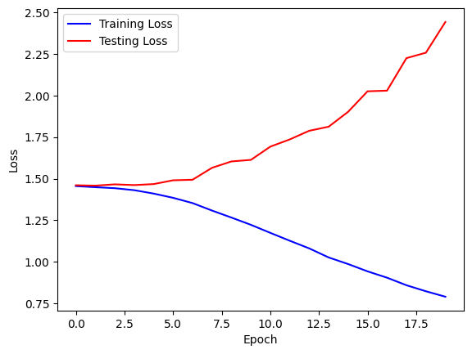
Result
10k training data
20k training data with 1 less convolutional layer
60k training data
20k training data with 0.5 dropout rate

Slide 37
Discussion
From the result we can see, no matter how we play with the hyperparameters or network architecture, the curve always looks roughly the same. The two right graphs looks very similar to the first few epochs of the left graphs, indicating that removing a convolutional layer or drop out 50% output from the first fulling connected layer only slows down the process of data being remembered. This indicates that the tuning the model architecture does not change much the “pattern” of the model remembering the data.
Given that CNN is a very common approach to learn DNA and protein sequence information in the field of bioinformatics, I conclude that model architecture is very unlikely to be the main reason for the overfitting problem.

Slide 38
Checking Label Validity
There is already a fair amount of introduced bias during the labeling process, yet I consider it the necessary approach for getting the labels we want. For example, normalization is necessary if we want to compare accessibilities under different experimental conditions, and we have to manually select k for the clustering algorithm, which is the same as manually set the boundary (this part of bias is greatly reduced with HSV transformation).

Slide 39
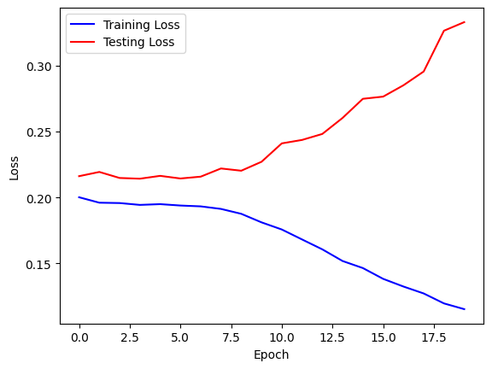
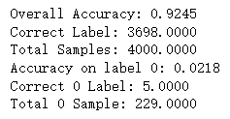
All that being said, it is still possible to improve the labels. The only pattern we care about is the V-shape pattern (aka. label 0), thus we can group all other labels to be simply label 1. By doing so, labeling noise is reduced, but at the same time, it raises another problem: there are only about 3.5k label 0’s but 65k label 1’s. This unbalanced label distribution might bias the model to predict label 1.
If we want to train the model with the new label distribution, we will have to punish false negative on label 0 more heavily than before.

Slide 40

Focal Loss
To solve the problem of imbalanced labels, we use Focal Loss instead of standard Cross-Entropy Loss to train our model. Focal Loss is given as ⁽⁵⁾:
By assigning different α values to different classes, Focal Loss could place unequal emphasis on the classes. On the other hand, γ controls for how much the model focuses on hard examples. In this project, we set γ conventionally to be 2, while tuning hyperparameter α, which is initially set to be [0.75, 0.25].
α could be set arbitrarily, the larger α₀/ α₁, the heavier we focus on correctly predict label 0.

Slide 41
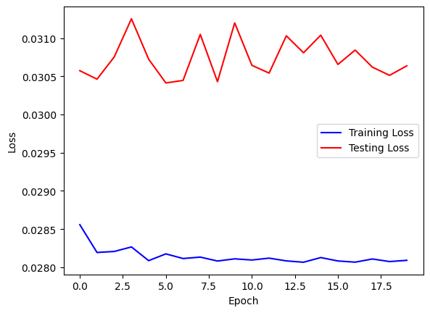
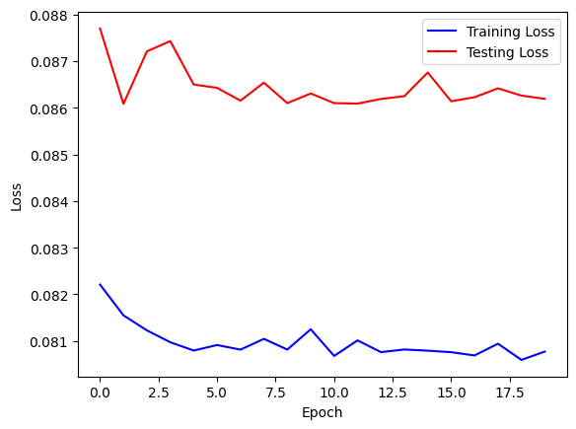
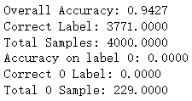
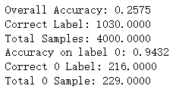
Result
α = [0.75, 0.25]
α = [5.0, 0.25]
When α₀/ α₁ is set too low or too high, the loss converges very quick, and the overall accuracy shows an extremely opposite pattern comparing to the accuracy on label 0. To eliminate the affect of unbalanced label, we want the two to be as close as possible.

Slide 42
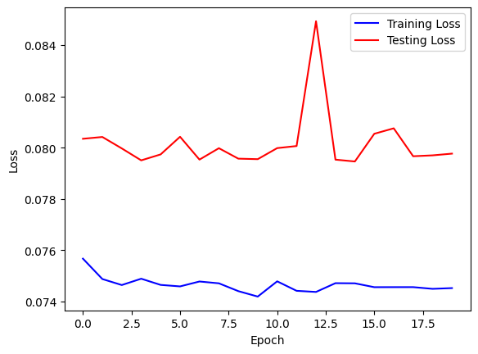
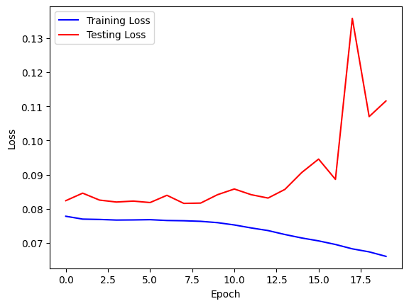




α = [4.5, 0.25]
α = [4.25, 0.25]
α₀/ α₁-
α₀/ α₁+
α = [4.75, 0.25]

Slide 43
Discussion
From the result above we can see that when we set α to be [4.5, 0.25], the overall accuracy was very close to the accuracy on label 0, meaning that we managed to cancel the effect of imbalanced labels. Yet, both accuracies are slightly above 50%, which means that even without the effect of imbalanced labels, our model is merely better than a random classifier. Also, there is still obvious pattern of overfitting.
Using Focal Loss instead of Cross-Entropy Loss, I have controlled the random noise from the labeling step to the best I could. This has not contributed to improving overfitting, thus I conclude that label quality is not a major cause to the overfitting problem.

Slide 44
Future plan
Now that we have eliminated the following hypothesizes of the cause of overfitting:
The model architecture is not a good fit
The model is too complex
The labels have poor quality
I will say that at this point, the most possible approach is to dig deeper into feature engineering of the original data. The same conclusion has been submitted to my research team, and my co-researchers are now working on capturing the complete distribution of intensity for each peak. This would result in a new channel with not only 0 and 1’s, but real number entries of length of the peaks to feed into the network. I expect it to make up for the lack of pattern in our current data and to become the possible fix for the overfitting problem.

Slide 45
Addressing Peer Review Comments
The most common comment (tongue twister?) I got from peer reviews was that this project did not follow a clear claim-evidence-reason story line. This is because that the project is part of a larger, ongoing research project, and I was only half way through my works at the point of the first draft presentation, so that no particular claims could be made. In this presentation, you could clearly see that I was finally able to make claims about what I thought was the reason for the overfitting problem.
Other comments including ambiguous wording, lack of explanations on choice of methodology, and unclear interpretation of analytic results were also addressed in this presentation.
One comment I found hard to address was that there were too much text with too few graphs and plots. Although I used a presentational format, this project should in fact be written as a formal research article. There was not as much to show directly to the readers as a data analysis article, but much more to interpret and discuss. Thus, in this executive level presentation, I still did not include many visualizations, but wrote long interpretational paragraphs instead.

Slide 46
Links
Project repository: https://github.com/N1colTeng/DATA-294P

Slide 47
Reference
(1) He et al., 2024, Cell. Dual-role transcription factors stabilize intermediate expression levels.
(2) Beibei Wang, Fengzhu Sun & Yihui Luan, 2024. Comparison of the effectiveness of different normalization methods for metagenomic cross‑study phenotype prediction under heterogeneity.
(3) Siersbæk et al., 2017, Molecular Cell 66. DynamicRewiring of Promoter-Anchored Chromatin Loops during Adipocyte Differentiation.
(4) Han Yuan and David R. Kelley, 2022. scBasset: sequence-based modeling of single-cell ATAC-seq using convolutional neural networks.
(5) Tsung-Yi Lin et al., 2017. Focal Loss for Dense Object Detection.

